Slide 1
Automated Deployments with GitHub Actions
Erin Dempster

Slide 2





Visit the Sponsor Booths
Lots of Great Raffle Prizes!
Enter your details on Raffle Entry Form & visit Sponsors to fill in Bingo card for Raffle prizes
Thank you Sponsors!
Gold Sponsors:
Silver Sponsors:
Blog Sponsors:
Notes:
Link to Raffle: https://forms.office.com/r/ZMSNL0Bbpp

Slide 3

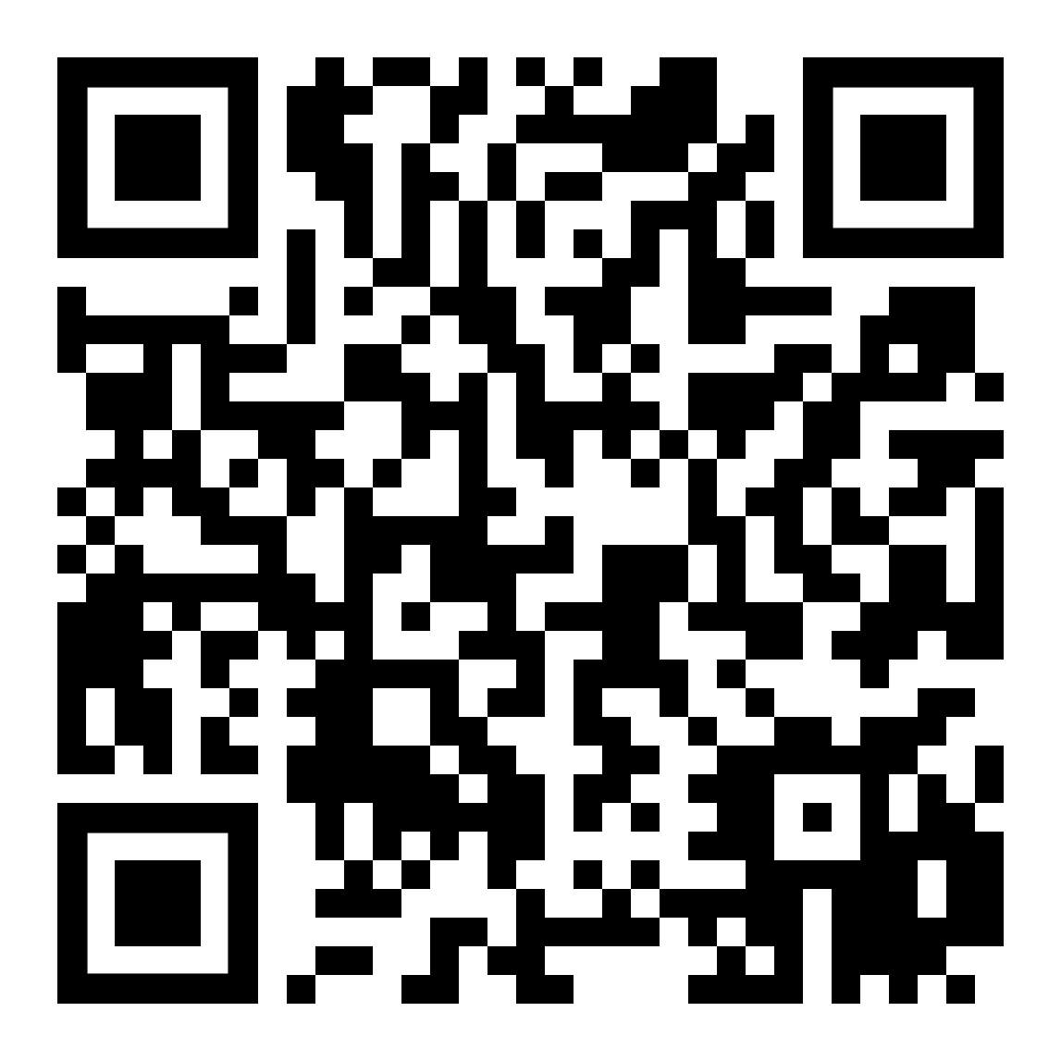

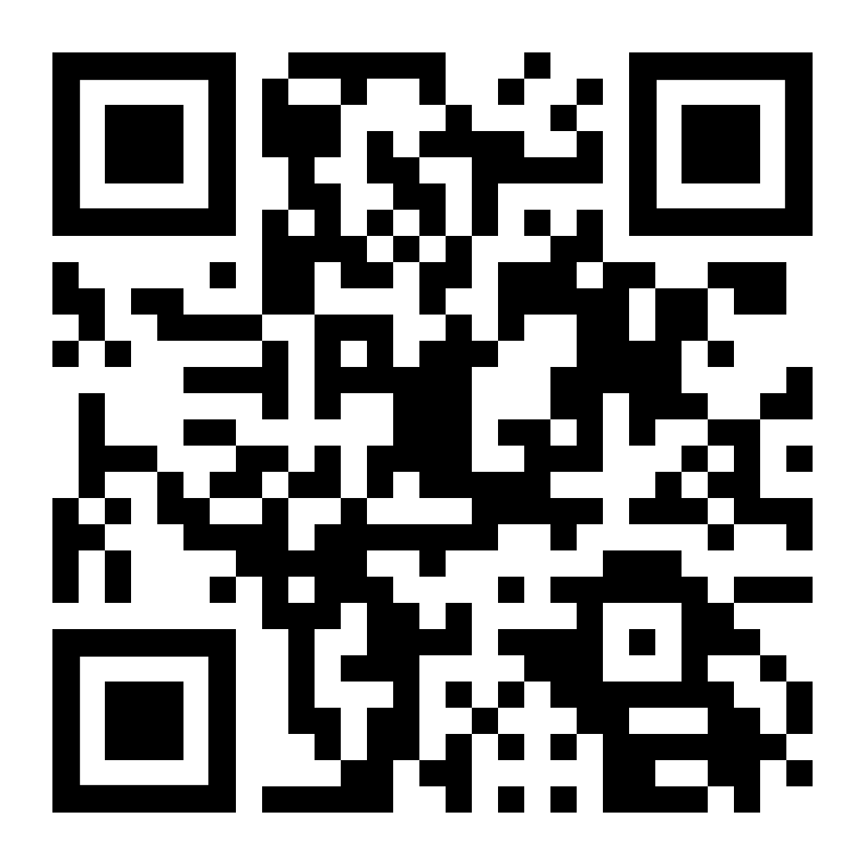
PASSMN – News/Info
Thanks to all our sponsors of 2024!
We need Speakers & Sponsors for 2025 PASSMN Meetings!
Sign up to present at one of the monthly meetings!
Monthly Meetup: 3rd Tuesday of Each Month
Signup on Meetup:
https://www.meetup.com/MN-SQL-Server-User-Group-PASSMN/
Board Member Elections in Q4:
Your chance to help the MN Data/SQL Community!
https://forms.office.com/r/rWfPhV6Chd

Slide 4


Connect, share, & learn with peers and thought leaders while celebrating all things data for a week of learning and networking opportunities.
November 4th Through November 8th in Seattle, WA
https://passdatacommunitysummit.com/

Slide 5


Erin
Dempster
She/Her
Enterprise Architect
SQL Server DBA
Azure Administrator
Azure DevOps Administrator
Speaker – PASS Summit, SQLBits +
Author – SQLServerCentral.com
Trean Corporation
https://www.erindempster.com
@em_dempster
https://www.linkedin.com/in/erindempster

Slide 6
Link to Today’s Content
https://github.com/endlessautomation/SQLSat

Slide 7
Who’s in the Audience?
Application Developers?
Database Developers?
Database Administrators?
IT Managers?

Slide 8
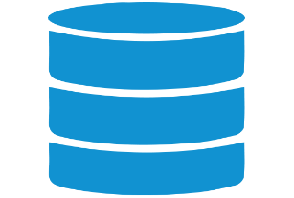



Agenda
GitHub Actions
Build
Automated Tests*
Approve
Deploy
Repeat 3&4
Test
Dev
Visual Studio
Reverse Engineer
Develop
Unit Test
Commit Changes
UAT
Prod
Git Client
Code
Repositories

Slide 9
Deployment Lifecycle
Dev
Test
UAT
Prod
Bug
Bug
Bug or Enhancement Request
Notes:
If you work on a disciplined team, the deployment cycle, or lifecycle, shouldn’t be a new concept to you. Before I worked at Trean, I had worked on reasonably disciplined teams, so I understood this process, though not some of the mechanics. When I started at Trean, almost 4 years ago, my team was not disciplined, so this lifecycle was totally unfamiliar to them.
Regardless, it’s still good to talk through this.
While server environments for one organization may look different than another’s, there is (or should be) a common theme to a deployment lifecycle. Developers make code changes in Dev. One the feature is coded AND unit tested, the code is passed on to a quality assurance analyst or team to run manual or automated tests. Once the tests all pass, the next step may be for end users to test the changes in a User Acceptance Testing (UAT) environment. If their testing passes, the code changes are ready for production.
At any point between development and production, defects could be discovered. Generally, they are passed back to the developers as bugs. Once the code is in production, bugs may (likely will) be discovered and reported. Hopefully more common, though, will be enhancement requests.
This sounds so much like a talk for application developers, doesn’t it? And yet, here I am at SQL Saturday, talking with database developers and DBAs. If you’re working on OLTP databases, providing the foundation for the application developers, you live this process in one form or another. For “isolated” data teams, like data warehouse teams, this may be more of a challenge. For my team of analysts turned developers, it was very much a challenge.

Slide 10
Deployment Lifecycle
How do we…
…accurately deploy only the required changes?
…consistently deploy changes between environments?
…make it repeatable over time?
…get timely feedback to developers?
Notes:
As a technical leader at Trean, these have been my challenges. Conceptually, we know answering these questions will lead to fewer bugs, a more stable environment, a happier company, and frankly, a happier team.
How do we get there? What can your team do to help answer these challenges?
Improving deployments means having pre-defined, tested procedures in place to do the same thing, across environments for the current build and across builds over time. What happens when different people or teams control different environments? If Bob deploys code to QA and John deploys to UAT and I deploy to production, what’s the likelihood the 3 of us are going to follow the procedures exactly??
Does this sound like a familiar situation?

Slide 11

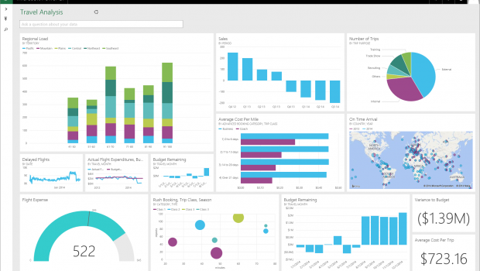
Automating Deployments
QA
Notes:
We’re going to automate the deployment of code to a single environment and provide time for approval in a repeatable manner. We have a database and maybe a Power BI dashboard using the database. Likely, there’s some kind of ETL process also needing to be deployed. The goal is to eliminate user intervention during the deployment of code to a single environment.
Of course, eventually, our code will be deployed to production, using similar processes. However, we should look at them as distinct processes in the life cycle.

Slide 12
Tools for Database Dev Ops
Destination | SQL Server Database (On-Prem/Cloud VM) |  | Azure SQL DB / Managed Instance
Orchestration | Azure Pipelines |  | GitHub Actions
Source Control | Azure DevOps |  | GitHub
Developer Tools | Visual Studio Database Project | Azure Data Studio Database Project | VS Code Database Project | Red Gate Flyway

Slide 13

Introduction to Visual Studio
SQL Database Project

Slide 14

Visual Studio – SQL Database Project
Long-Time Support for SQL Databases
Build Projects with msbuild.exe
Creates a .DACPAC for Deployment

Slide 15
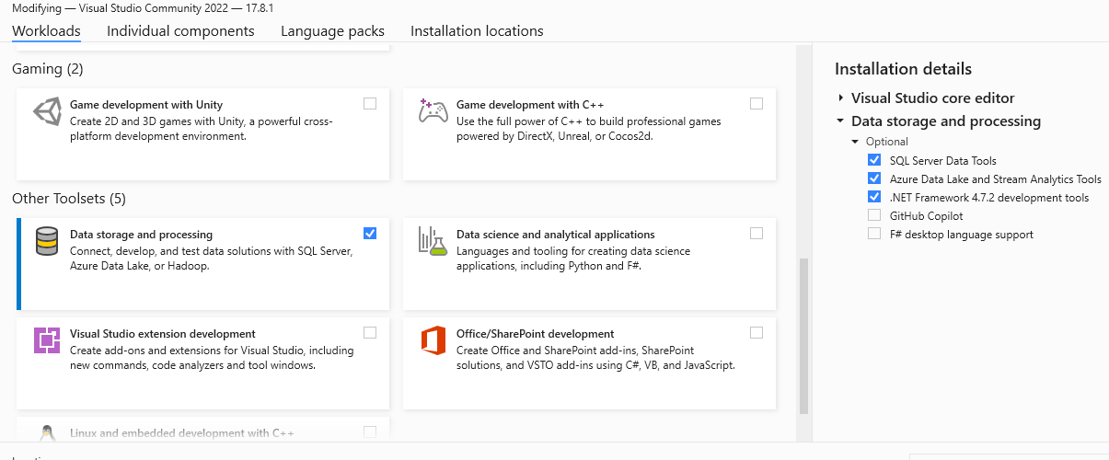
Visual Studio Installer

Slide 16
SQL Database Project Demo

Slide 17
Introduction to GitHub

Slide 18
GitHub
Public-focused Source Control Solution
Code-focused
Tasks limited to Issue Logs
Often integrated with Jira for task boards
Acquired by Microsoft in 2019

Slide 19
Source Control Demo

Slide 20
Branching Code

Slide 21
Branching Strategy
main branch
Harder to determine when to start workflow
Trigger after view change?
Trigger after table change?

Slide 22
Branching Strategy
Developer branch and main
Changes are merged into the ‘main’ branch
main
PR

Slide 23
Branching Strategy
Developer branch and main
Potential issues
All features/hotfixes must pass
Bugs can hold up other code (reverts help)
main
PR

Slide 24
Large Team Branching Strategy
Starting Point
Hotfix202409.1.1
Hotfix202409.1.2
Release202410.1
main
hotfix
PR
PR
releasefix
UAT Begins
PR
release
PR
dev
feature 1
PR
QA Failed
PR Reverted
QA Passes
w/Bug Fix
feature 2
PR
PR
feature 3
PR
feature 4
PR

Slide 25
Pull Request
Developer believes code is finished
Changes are grouped together
Associate work items
Requirements
Bugs
Require approval by another team member

Slide 26
Automating Processes

Slide 27
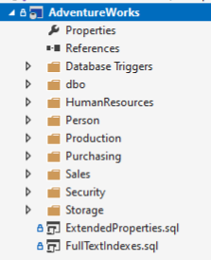
GitHub Actions
Manages code builds and deployments
Triggered from many events
Code check-ins (push)
Pull Requests (pull_request)
Define YOUR workflow with YAML!

Slide 28
What is YAML?
“YAML Ain’t Markup Language
Configuration Layout
Used by both GitHub Actions and Azure Pipelines

Slide 29
Links to GitHub Actions
Workflow Syntax - https://tinyurl.com/4yz9bmjr
Actions Marketplace - https://tinyurl.com/386ner8r

Slide 30
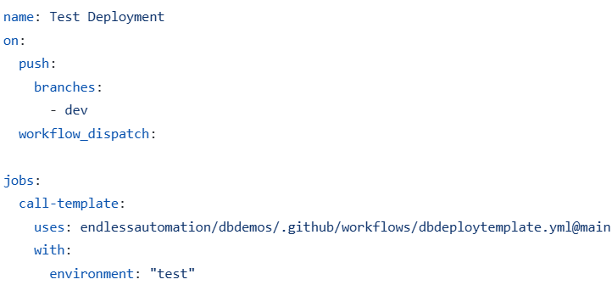
Workflows
Define
Name of the process
When the automation runs
Set of jobs to execute

Slide 31
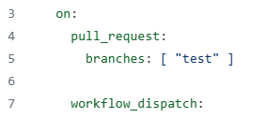

GitHub Workflow - Triggers
Quick Example #1
2 Triggers
Pull request going to ‘test’ branch
Workflow runs when Pull Request is opened
Manual trigger, workflow_dispatch
Quick Example #2
1 Trigger - Push code to ‘dev’ branch

Slide 32
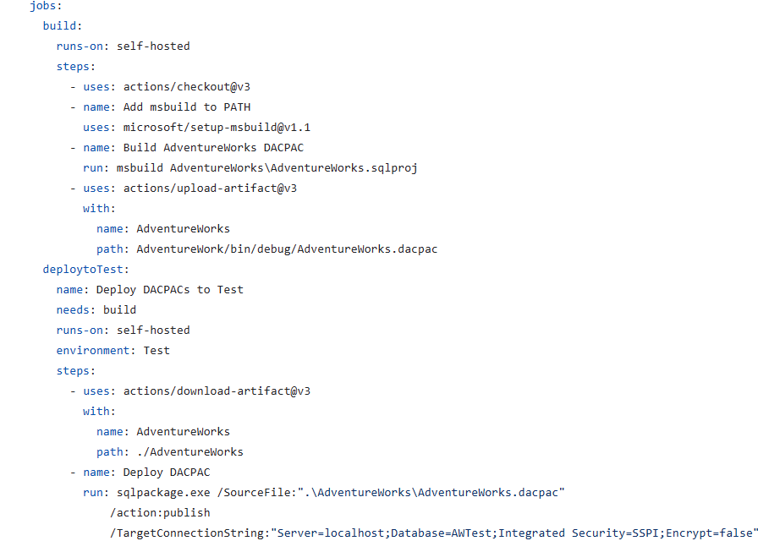
Jobs
Run
Sequentially
Parallel
Defines the execution steps
Reusable as a template

Slide 33
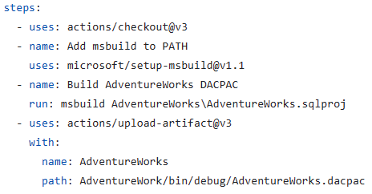
2 Jobs

Slide 34
Static Definition

Slide 35
Reusable Workflow
Define a process template
Set values at runtime with
Parameters
Environment Variables
Call the workflow from “caller workflow”

Slide 36
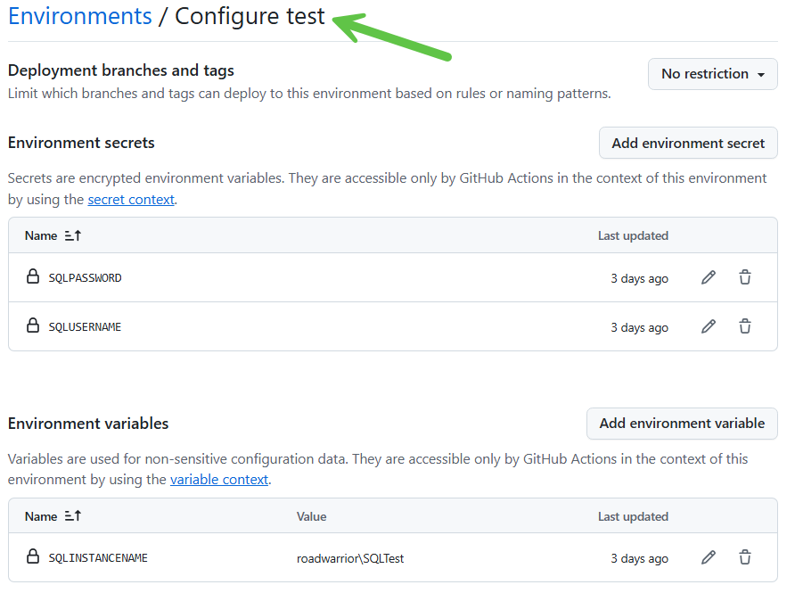
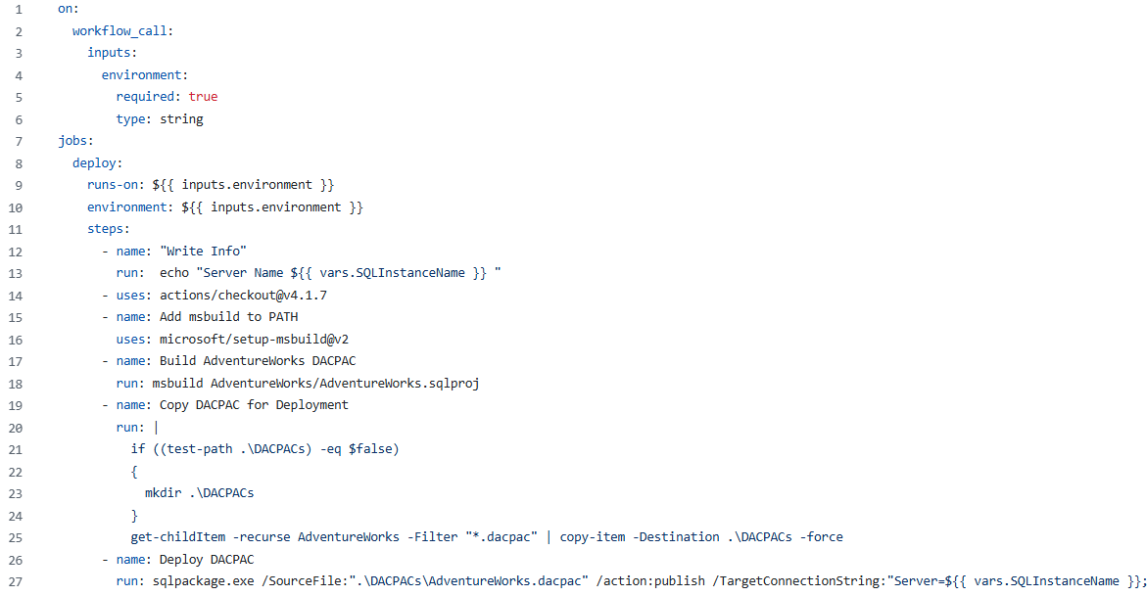
Reusable Workflow

Slide 37
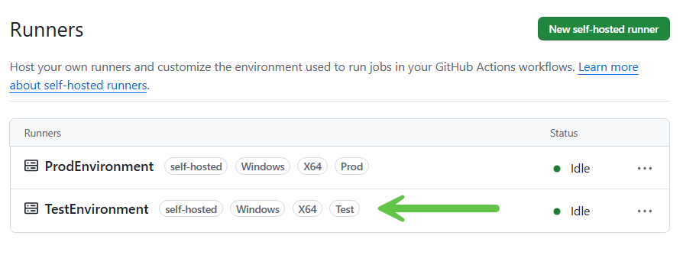
Reusable Workflow

Slide 38
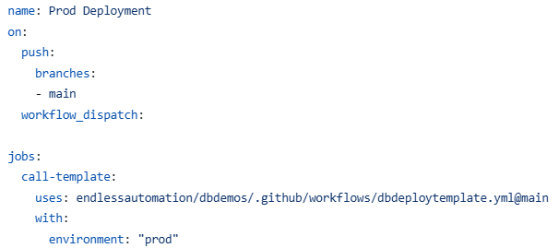
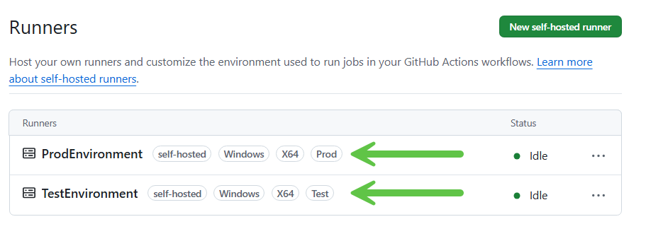
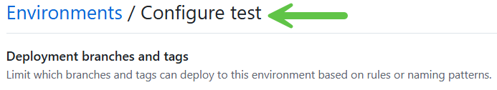
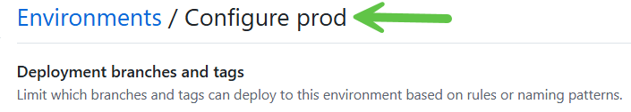
Reusable Workflow – Caller Workflows

Slide 39

Runners
Workflow Execution Agent
GitHub-hosted
Windows
Ubuntu
Self-hosted
Windows
Linux
Mac
← Considerably faster

Slide 40
Wrap-up
Manage Database Schema in Source Control
Build and deploy changes with little effort
Use Reusable Workflows for consistent deployments
Deploy with self-hosted runners

Slide 41
Link to Today’s Content
https://github.com/endlessautomation/SQLSat

Slide 42
Questions???

Slide 43
Thank you!
https://erindempster.com
LinkedIn: https://linkedin.com/in/erindempster

